Slide 1

Hershey (NYSE: HSY)
Short Recommendation
2025 PT: $184.19 (-7% Downside)
April 12th, 2024
Leo Goldberg, Landry Mize, Dawson Prewett

Slide 2
Company Overview
Company Highlights
Current Share Performance
History: The Hershey Company is an American food manufacturing company founded in 1894 by Milton Hershey. It is the 4th largest distributor of Chocolate in the world with revenue of 11.165 Billion for 2023 with 81.71% of that being from the North America Confectionary Segment.
Ownership: 2.71% (Insiders), 19.83% (Mutual Funds) , 23.63% (Other Financial Institutions), 53.83% (Public Companies and individual investors).
Current Major Investors: Elo Mutual Pension Insurance Company, Hershey Trust Company, Keskinäinen Eläkevakuutusyhtiö Ilmarinen, Milton Hershey School Trust, Keskinäinen työeläkevakuutusyhtiö Varma, T. Rowe Price Associates, Inc..
Current Key Statistics ($mm)
Enterprise Value | $44,202.3 | Revenue (FY18e) | $968
Market Cap | $39,478.6
P/E* | 26.90x | EBITDA Margin | 26.4%
EV/EBITDA* | 14.97x | Debt / EV | 11.60%
Cash | $401.9 | Total Debt | $5125.6
*P/E and EV/EBITDA are based on FY23(e) for comparison
Share Price | Current: 189.50 | 52 Wk High/Low: $178.82-276.88
Key Stats (2023) | Percentages
Gross Margin | 44.8%
EBITDA Margin | 26.4%
D/E | 125%
Growth Over Prior Year (Revenue) | 7.2%
EBIT Margin | 22.7%
Segment Revenue Mix | % | Gross ($mm)
North America Confectionary | 81.71% | 9123.1
Salty Snacks | 9.79% | 1092.7
International | 8.5% | 949.2

Slide 3
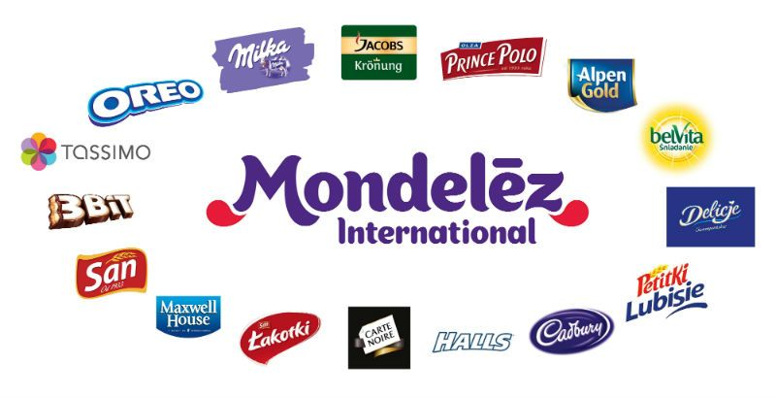


Competitive Environment
Competitors
Mondelez International (In millions)
Total Sales: $36,016
Chocolate Sales: $14,400
Mars Inc. (In millions)
Total Sales: $50,000
Chocolate Sales: $22,000
Ferrero (In millions)
Total Sales: $18,244
Chocolate Sales: $13,080

Slide 4
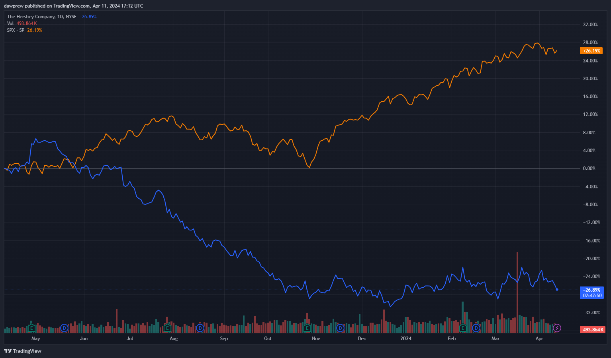
Comparison vs S@P 500 index
Comparison Chart
Equity | % (1 YR) (April 11th)
The Hershey Company (HSY) (BLUE) | -26.89%
S@P 500 Index (SPX) (ORANGE) | 26.19%

Slide 5
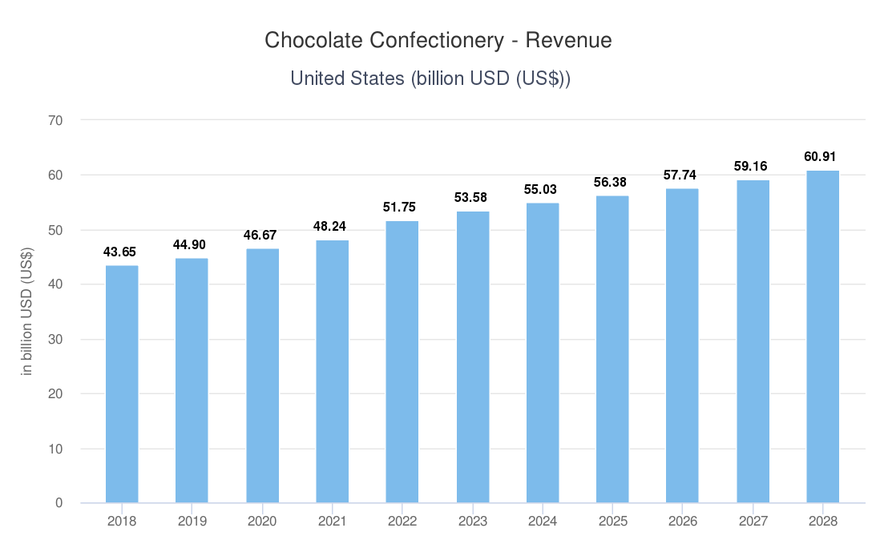
Key Industry Trends
Industry Overview (Packaged Food and Meats )
Total Revenue of Chocolate Confectionary Market (2018-2028)
Industry Revenue Breakdown by Major Segment (2023)
Total Value (US) | $1080.3 Billion
Largest Segment in US (America Confectionary) | 313 Billion
Key Industry Averages
Total Debt/EV ratio | 65.6%
EBITDA margin | 13%
EV/EBITDA | 15.8x
P/E Ratio | 19.6x
Global Industry
Total revenues | $3001 Billion

Slide 6
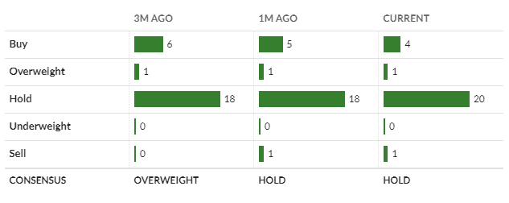
Investment Reasoning – Why Bother Shorting?
Investment Thesis
Headwind 1: Cocoa production has seemingly halted in the Ivory coast due to over-farming, adverse weather conditions, and crop diseases that were not anticipated.
Analyst Consensus? They Don’t Know
Headwind 2: Palm oil futures are rising in accordance with cocoa due to over-farming, labor issues within Malaysia, and adverse weather conditions predicted in Indonesia. This is significant as 9/12 of Hershey’s suppliers are located in these two countries.
Headwind 3: Chocolate confectionary demand is continuously declining compared to other confectionary markets, which Hershey have a much smaller portion of.
Hershey is not prepared to for the upcoming agricultural markets, furthering their increase on prices. Consumers are not responding well, and will not continue to tolerate prices being put on them.

Slide 7
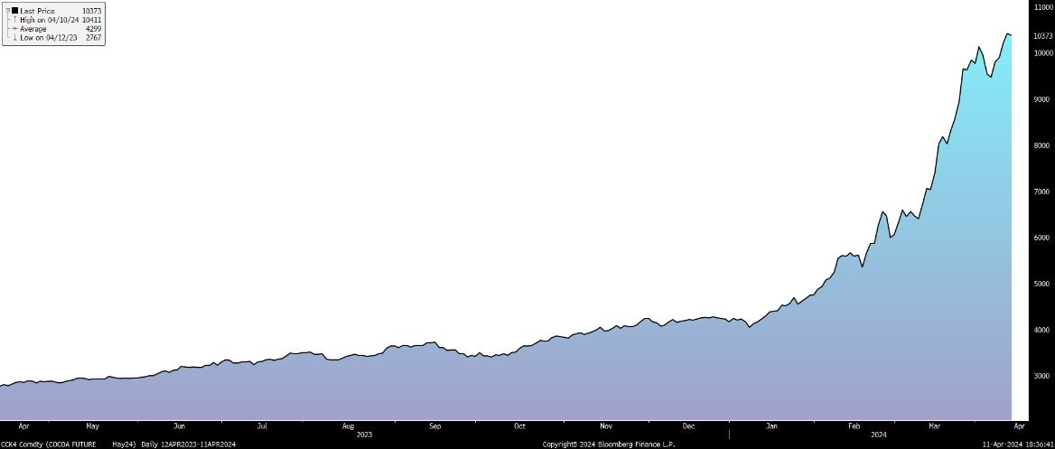
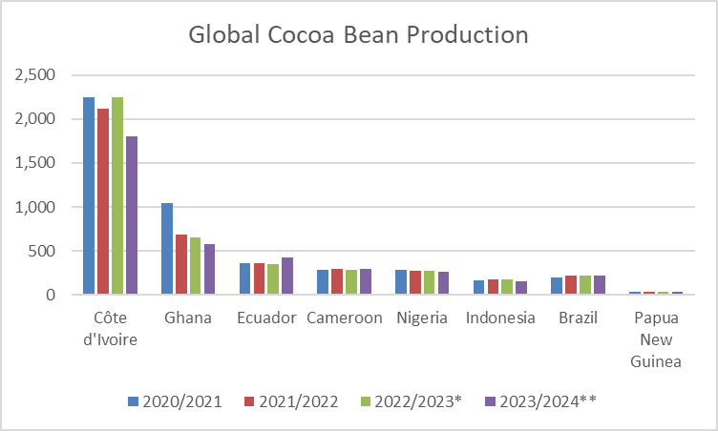
Headwind 1: Cocoa Production
Worst Case Scenario for Cocoa Farmers
Global cocoa production is expected to fall to 4.5 million metric tons in the current crop year, resulting additional 330,000 metric tons still needed to meet demand. This imbalance is supposed to worsen in the next coming years, expecting to cover only 31.4% of processing demand, a decrease of 3.7% YoY.
CCK4 – Cocoa Futures May 2024
52 Week High – $10,411
52 Week Low - $2,767
Hershey has 70% of its future hedging expiring in 2024. Cocoa futures are expected to rise over time into 2025 according to Hershey's competitors, thus impacting Hershey's ability to efficiently hedge against the long-term increase in future prices.
The Ivory Coast is by far the largest producer of cocoa beans within recent history, producing over 47% of the world's total production. Their production is expected to fall by 28.5% within the current quarter due to adverse weather effects and new child labor laws cracking down on producers.

Slide 8
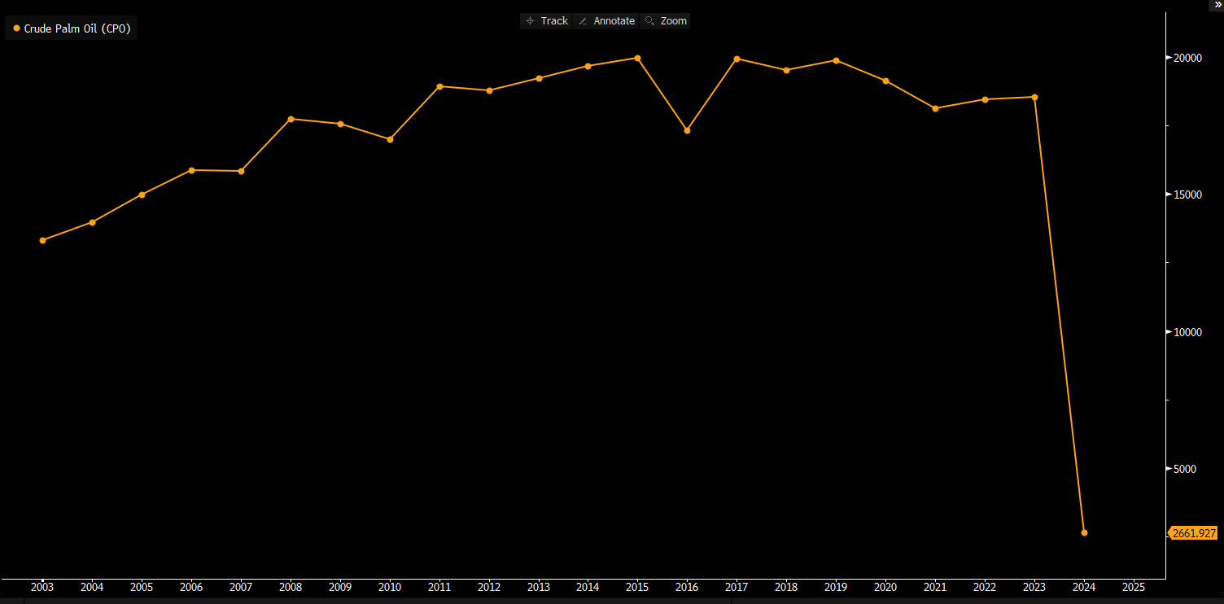
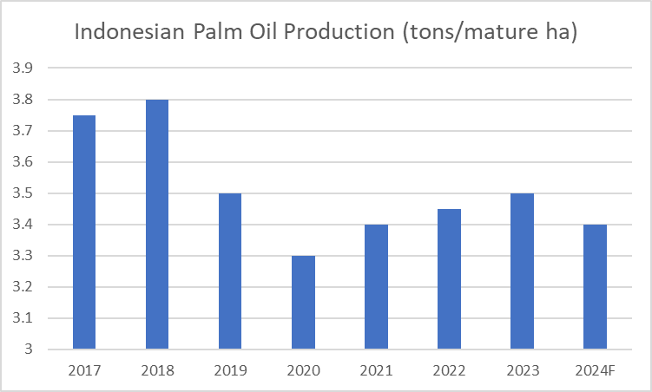
Headwind 2: Palm Oil Futures
Further Agricultural Troubles
While there are many additional sources of Palm Oil Hershey could pursue, the company is committed to verifying the ESG impact of partner distributors before pursuing an agreement. This commitment would prevent Hershey from switching to a cheaper alternative if necessary.
Palm oil futures are rising in accordance with cocoa due to over-farming, labor issues within Malaysia, and adverse weather conditions predicted in Indonesia. This is significant as 9/12 of Hershey’s suppliers are located in these two countries.
Gradual stagnation and decline of palm oil production since 2012 in Malaysia

Slide 9
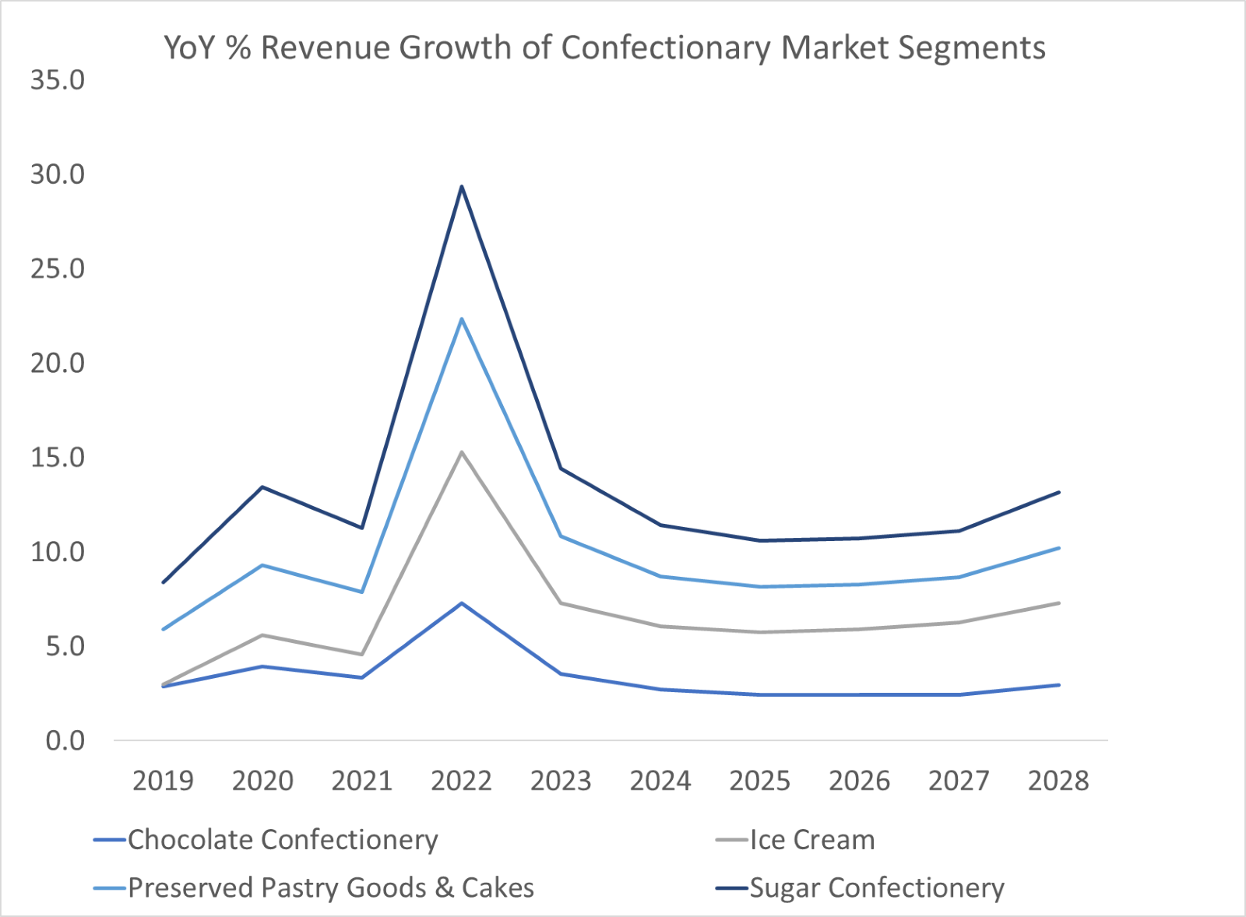
Headwind 3: Confectionary Market Troubles
Declining Industry Struggles
Consumers do not want chocolate any more. It is the slowest growing confectionary market segment, even experiencing slight decline.
The demand for non-chocolate products saw a 12.1% increase in 2023, doubling chocolate's 5.8%. Unit sales also decreased by 5.3% for chocolate goods.
44% of consumers recently reported purchasing chocolate less often, with 30% claiming they only buy what is on sale.

Slide 10
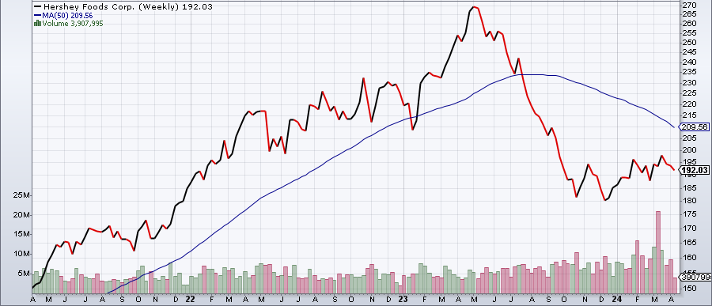
Historical Share Price Performance – 50 Day Moving Average
Key Events & Share Price Drivers

Slide 11
Discounted Cash Flow Model & EPS
Notes:
“ 1,000 key Grand Hyatt-managed hotel, 2,000 condominium hotel
units totaling approximately 2,232,000 square feet, a 75,000 square foot
casino, 275,000 square feet of retail and restaurant space, 150,000 square
feet of meeting and ballroom space” - http://greatlasvegascondos.com/cosmopolitan_construction_financing.htm
2,200 condo-hotel units or 2,000 units?
“Approximately 2,700 keys comprised of luxury condo-hotel units and hotel rooms with over 1,700 condo-hotel units offered for sale” - http://www.hotel-online.com/News/PR2005_2nd/Apr05_HyattCosmopolitan.html
“- Initial developer Ian Eichner exhausts project funding / defaults on construction loans of $760 million and enters foreclosure” - http://www.examiner.com/article/cosmopolitan-the-rocky-past-and-uncertain-future-of-the-newest-vegas-resort
- Confirmed at 760 with Bloomberg article
€500m write-off in 2009 (annual report 2010) ~ $750m

Slide 12
Appendices

Slide 13
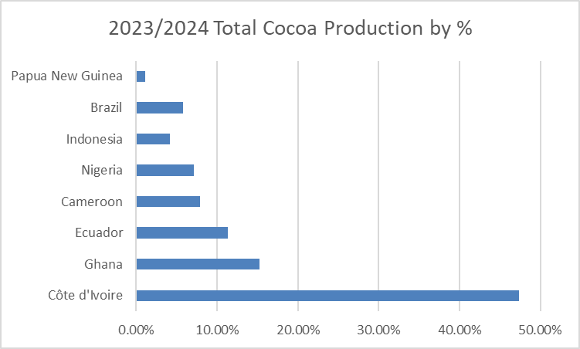
Appendix I – Ivory Coast Cocoa Production by %

Slide 14
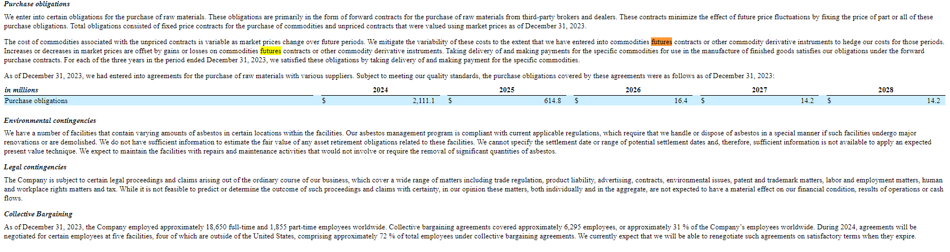
Appendix 2 – 10k: Purchase Obligations

Slide 15
Appendix 3 – Pro Forma Income Statement

Slide 16
Appendix 4 – Pro Forma Balance Sheet Pt 1

Slide 17
Appendix 5 – Pro Forma Balance Sheet Pt 2

Slide 18
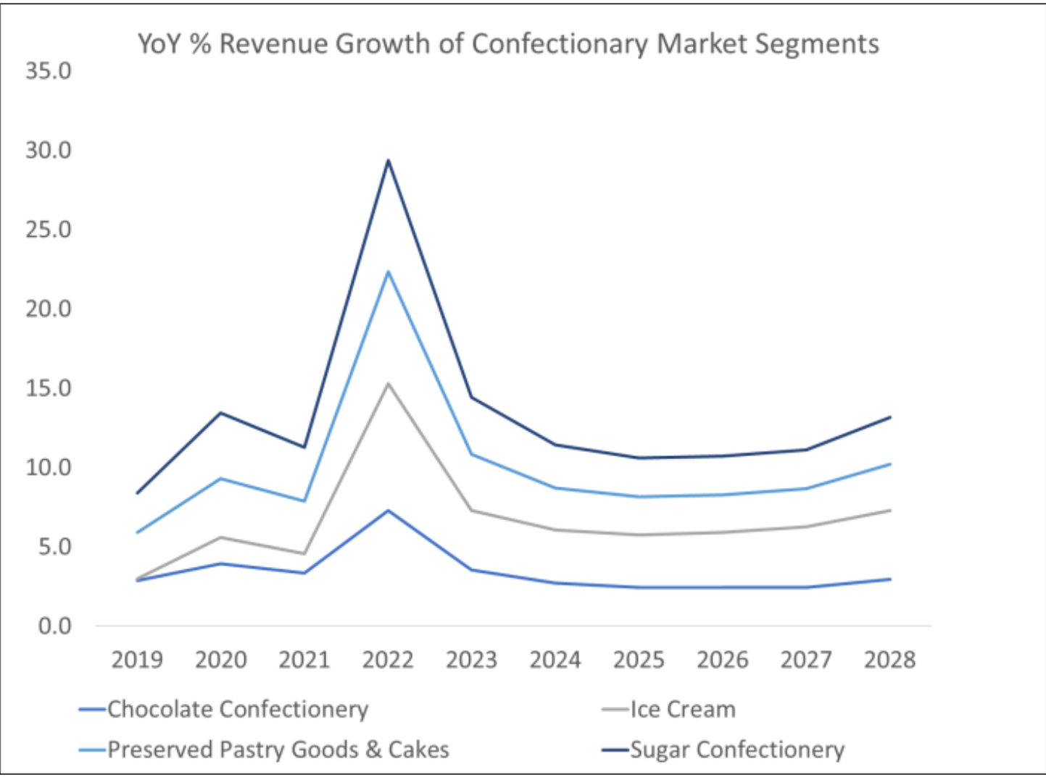
Appendix 6 – Confectionary Market Data

